Slide 1
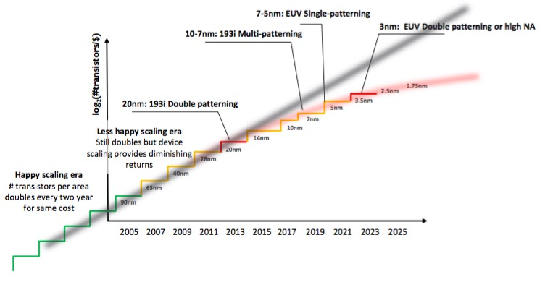
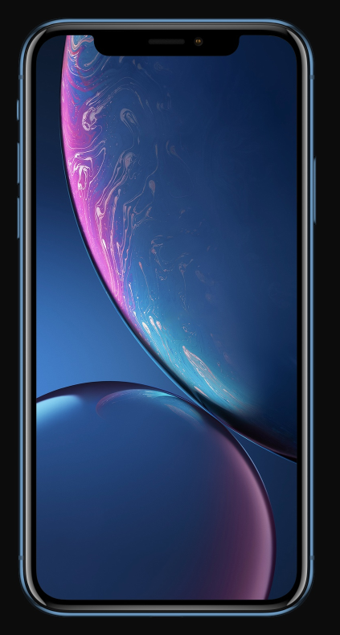
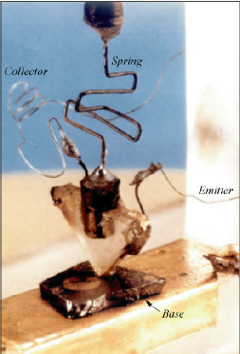
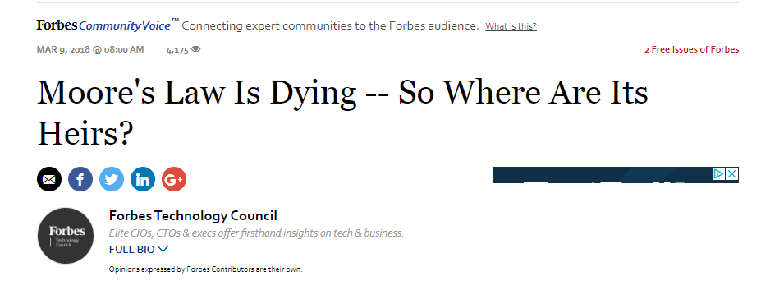
New Directions in Electronics
Bell labs,
1947.
7Billion
FET
2018
Notes:
1
To print: 1,4,5,7,8,9,15,16,18,23,24,25,26,29,30,31,34,35,40,41,43,46,47,48,51,55,60,61,62,63
Hosszutav jovo elektornikaja
Folztatni a miniaturiyalast → molekularis elektronika
Uj koncepciokat kidolgozni szamitasokra…
Kis meret tartomanyban maskeppen viselkedik egy eszkoz. Pl. Kvantummechanikailag,
Vagy ballisztikusan → elektron optika
Szamos objektum nanotechnologia teruleterol, amibol aramkoroket lehet kesziteni.

Slide 2
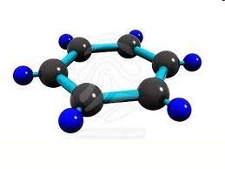
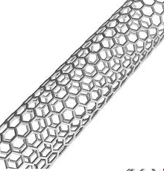
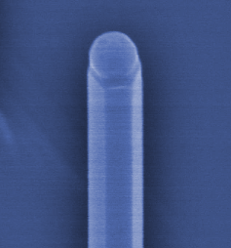
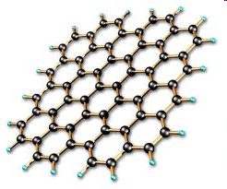
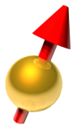


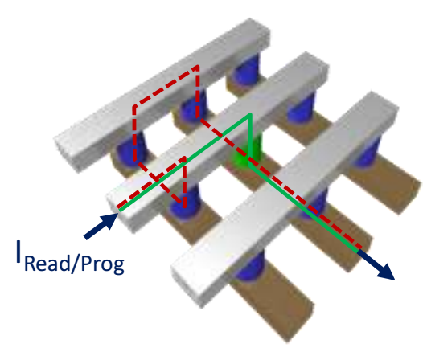
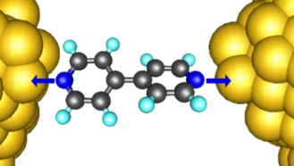
New Directions in Electronics
LBohr
Le
Lφ
Lspin
Spintronics
Quantumelectronics
Molecular
electronics
Memristors
Notes:
2
To print: 1,4,5,7,8,9,15,16,18,23,24,25,26,29,30,31,34,35,40,41,43,46,47,48,51,55,60,61,62,63
Hosszutav jovo elektornikaja
Folztatni a miniaturiyalast → molekularis elektronika
Uj koncepciokat kidolgozni szamitasokra…
Kis meret tartomanyban maskeppen viselkedik egy eszkoz. Pl. Kvantummechanikailag,
Vagy ballisztikusan → elektron optika
Szamos objektum nanotechnologia teruleterol, amibol aramkoroket lehet kesziteni.

Slide 3
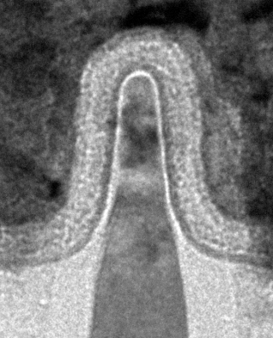
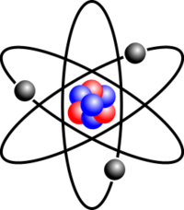
Towards quantum
MosFET: Bottleneck is leakage
Nanoscale objects:
Small is different. E.g.
- Single electron transistor (Quantum dots)
- If L ≈ λF or L φ various quantum effects….
Atoms, molecule: Full quantum description
Schrödinger equation → Periodic table
Notes:
- In present chip industry quantum mechanics place a major limitation of further miniaturization. Insulator barriers with a few atom layer width. Gate leakage due to tunneling effect
- Scale of atoms and molecules, full quantum limit. Schrodinger equation dictates the behaviors, periodic table etc.
Nanoscale objects lambda_F comparable to the size: e.g. two tunnel barriers forming a quantum dot.
As long as quantum effects are a limitation for electrical engineer, a great advantage and playground for physicists. Try to take as an advantage…. Quantum behavior is richer than classical one. → Define controllable quantum systems with manipulation and read out possibility.

Slide 4
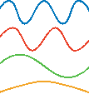
Quantum in electronics
MosFET: Bottleneck is leakage
Nanoscale objects:
If L ≈ λF or L φ various quantum effects….
E.g. Quantum Dot (Artificial atom)
λF
~
λF
Notes:
- In present chip industry quantum mechanics place a major limitation of further miniaturization. Insulator barriers with a few atom layer width. Gate leakage due to tunneling effect
- Scale of atoms and molecules, full quantum limit. Schrodinger equation dictates the behaviors, periodic table etc.
Nanoscale objects lambda_F comparable to the size: e.g. two tunnel barriers forming a quantum dot.
As long as quantum effects are a limitation for electrical engineer, a great advantage and playground for physicists. Try to take as an advantage…. Quantum behavior is richer than classical one. → Define controllable quantum systems with manipulation and read out possibility.

Slide 5
Quantum in electronics
MosFET: Bottleneck is leakage
Nanoscale objects:
If L ≈ λF or L φ various quantum effects….
E.g. Quantum Dot (Artificial atom)
λF
Γ1
Γ2
=
=
E
QD
E
~
λF
See more: Fundamentals of Nanoelectronics,
A. Palyi: Quantum Information Processing
Notes:
- In present chip industry quantum mechanics place a major limitation of further miniaturization. Insulator barriers with a few atom layer width. Gate leakage due to tunneling effect
- Scale of atoms and molecules, full quantum limit. Schrodinger equation dictates the behaviors, periodic table etc.
Nanoscale objects lambda_F comparable to the size: e.g. two tunnel barriers forming a quantum dot.
As long as quantum effects are a limitation for electrical engineer, a great advantage and playground for physicists. Try to take as an advantage…. Quantum behavior is richer than classical one. → Define controllable quantum systems with manipulation and read out possibility.

Slide 6
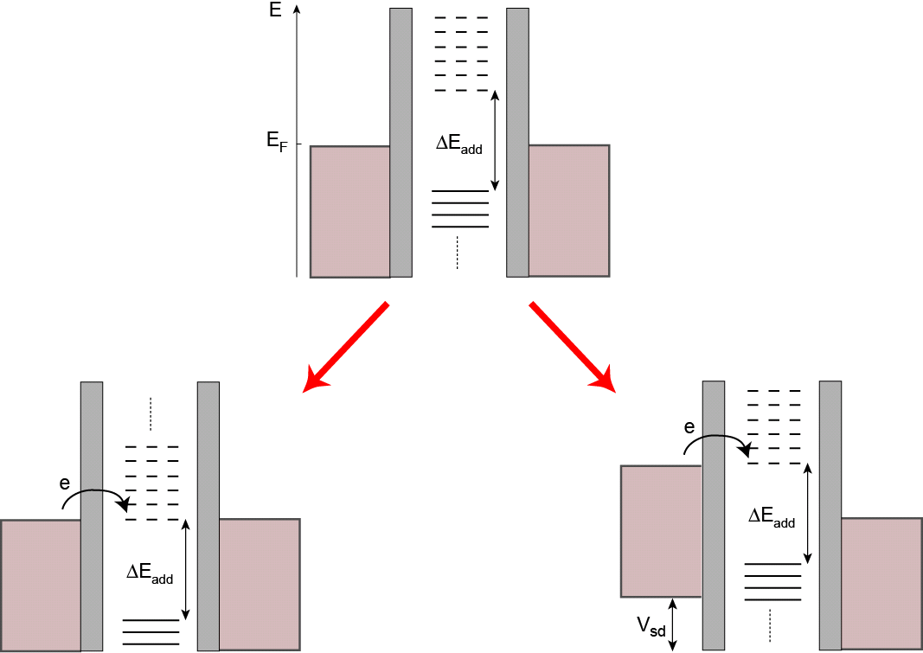
Quantum Dots
discrete energy spectrum, εi
Coulomb interaction, UC
→ Coulomb blockade
Gate electrode to shift energy levels, Vg
Γ: coupling to electrodes
Gate assisted transport
Bias assisted transport
λF
Γ1
Γ2
=
=
E
QD
E
~
λF
Notes:
- In present chip industry quantum mechanics place a major limitation of further miniaturization. Insulator barriers with a few atom layer width. Gate leakage due to tunneling effect
- Scale of atoms and molecules, full quantum limit. Schrodinger equation dictates the behaviors, periodic table etc.
Nanoscale objects lambda_F comparable to the size: e.g. two tunnel barriers forming a quantum dot.
As long as quantum effects are a limitation for electrical engineer, a great advantage and playground for physicists. Try to take as an advantage…. Quantum behavior is richer than classical one. → Define controllable quantum systems with manipulation and read out possibility.

Slide 7
Quantum Dots
Gate assisted transport
Bias assisted transport
Gate voltage
0.6
0
Gate
GII(2e²/h)
Γ2
=
λF
Γ1
=
E
QD
E
~
λF
Notes:
- In present chip industry quantum mechanics place a major limitation of further miniaturization. Insulator barriers with a few atom layer width. Gate leakage due to tunneling effect
- Scale of atoms and molecules, full quantum limit. Schrodinger equation dictates the behaviors, periodic table etc.
Nanoscale objects lambda_F comparable to the size: e.g. two tunnel barriers forming a quantum dot.
As long as quantum effects are a limitation for electrical engineer, a great advantage and playground for physicists. Try to take as an advantage…. Quantum behavior is richer than classical one. → Define controllable quantum systems with manipulation and read out possibility.

Slide 8
Quantum electronics
MosFET: Bottleneck is leakage
Nanoscale objects:
If L ≈ λF or L φ various quantum effects….
Quantum electronics:
Beside understand quantum effects the goal is to
create well defined quantum subsystems,
control and manipulate them
Take the advantage of QUANTUM!
Notes:
- In present chip industry quantum mechanics place a major limitation of further miniaturization. Insulator barriers with a few atom layer width. Gate leakage due to tunneling effect
- Scale of atoms and molecules, full quantum limit. Schrodinger equation dictates the behaviors, periodic table etc.
Nanoscale objects lambda_F comparable to the size: e.g. two tunnel barriers forming a quantum dot.
As long as quantum effects are a limitation for electrical engineer, a great advantage and playground for physicists. Try to take as an advantage…. Quantum behavior is richer than classical one. → Define controllable quantum systems with manipulation and read out possibility.

Slide 9
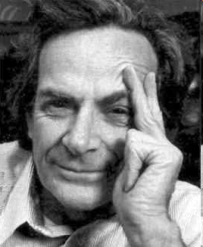
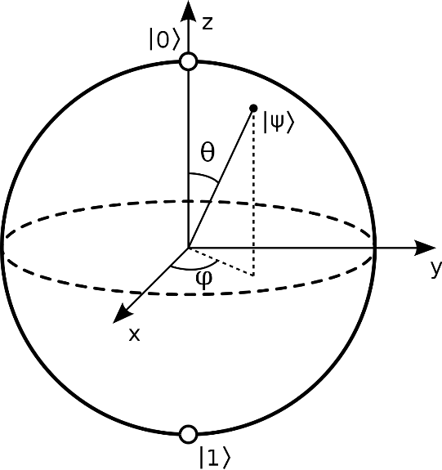




Principles: Qubit
“When we get to the very, very small world… We can manufacture in different ways. We can use, not just circuits, but some system involving the quantized energy levels, or the interactions of quantized spins, etc.”
Classical
Quantum
0
1
0
1
Feynman
or
$$|0>$$
$$a|0>+ b|1>$$
$$a=r+\sqrt{−1}q$$
$$|ψ> =cos⁡(θ/2)|0>+\sin\left(θ/2\right)e^{iφ}|1>$$
Compared to a classical bit much more information can be encoded
$$|1>$$
Notes:
Basic unit to store quantum information: qubit
Classical two level system, quantum two level system.
Kvantum mechanika alapjait erinto kerdeskor…
Fizika ket uj teruletenek a megszuletesehez vezetett…
Eroforrasava valt
Kvantum rendszerek szimulaciojat mar Feynman 82 megsejtette, 96 ban elso ilyen algoritmusok
Pl.:
Estimation of the eigenvalues and eigenvectors of a Hamiltonian (this algorithm invokes
the QFT), which can be used to find the energy levels of an atom for example [AL99].
• Simulation of the dynamics of many-body Fermi systems, using either first or second
quantized descriptions [AL97].
• Simulation of quantum chaos and localization [GS01].
Kvantum mechanika linearitasa miatt egy kvantum mechanikai logikai kapu
parhuzamosan transzformalja az osszes kombinaciojat a ket qubites allapotnak.
Jo tudni:
- Nehany fontos eset van, ahol exponencialisan jobb a kvantum szamitogep
- Normal szamitast pl. szamok osszeadasat nem gyorsitan fel a kvantum szamitogep
- Nem minden problema eseteben okoyna exponencialis sebesseg novekedest
Kvantum algoritmusok felfedezese uj dimenziokba helyezte fizika, szamitaselmelet es informacioelmelet tudomany agait.

Slide 10




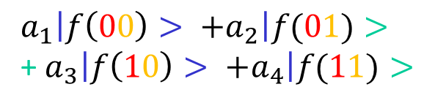

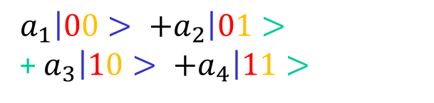





Principles: Qubit
$$a|0>+ b|1>$$
Two qubit
$a_{1}\left|00> +a_{2}\right|01>$ +${ a}_{3}\left|10> +a_{4}\right|11>$
Measurement
f quantum gate
Probability to get 0: |a|²
Probability to get 1: |b|²
$a_{1}\left|f\left(00\right)> +a_{2}\right|f(01)>$ +${ a}_{3}\left|f\left(10\right)> +a_{4}\right|f(11)>$
Control: RF techniques learned from NMR
Quantum parallelism: parallel evaluations grow exponentially with the number of Qubits (≈2^{n})
0
$$B_{rf}$$
Entanglement
0
$$|01> +|10>$$
$π/2$-pulse
$$ℏω_{q}$$
Measurement QuBit 1 results in |1>
$π$-pulse
Qubit Hamiltionian
$$|10>$$
$$H=ℏω_{q}σ_{z}$$
Nonlocality: manipulation of
QuBit1 has consequence on QuBit2
$$B_{rf}$$
Notes:
Basic unit to store quantum information: qubit
Classical two level system, quantum two level system.
Kvantum mechanika alapjait erinto kerdeskor…
Fizika ket uj teruletenek a megszuletesehez vezetett…
Eroforrasava valt
Kvantum rendszerek szimulaciojat mar Feynman 82 megsejtette, 96 ban elso ilyen algoritmusok
Pl.:
Estimation of the eigenvalues and eigenvectors of a Hamiltonian (this algorithm invokes
the QFT), which can be used to find the energy levels of an atom for example [AL99].
• Simulation of the dynamics of many-body Fermi systems, using either first or second
quantized descriptions [AL97].
• Simulation of quantum chaos and localization [GS01].
Kvantum mechanika linearitasa miatt egy kvantum mechanikai logikai kapu
parhuzamosan transzformalja az osszes kombinaciojat a ket qubites allapotnak.
Jo tudni:
- Nehany fontos eset van, ahol exponencialisan jobb a kvantum szamitogep
- Normal szamitast pl. szamok osszeadasat nem gyorsitan fel a kvantum szamitogep
- Nem minden problema eseteben okoyna exponencialis sebesseg novekedest
Kvantum algoritmusok felfedezese uj dimenziokba helyezte fizika, szamitaselmelet es informacioelmelet tudomany agait.

Slide 11
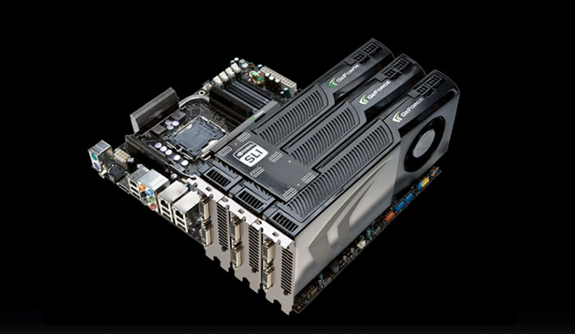
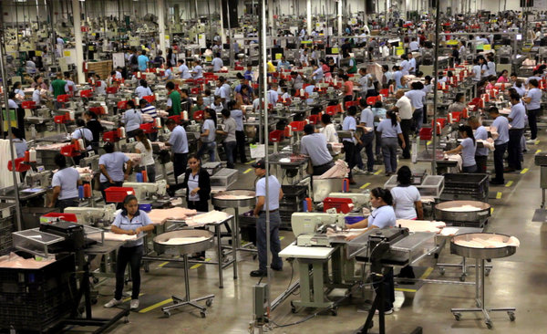
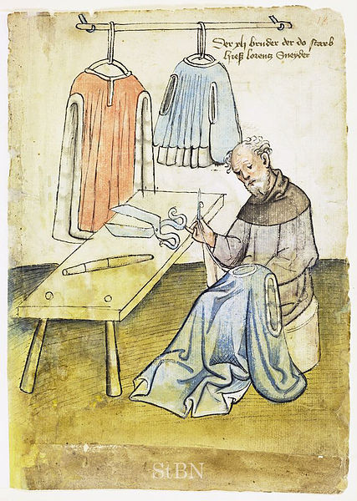
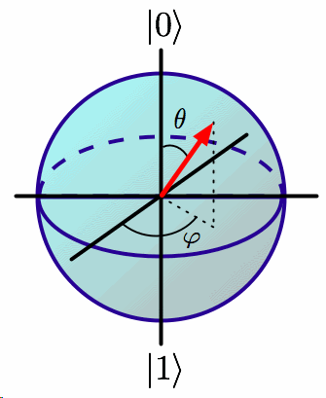
Principles: How powerful?
f is a quantum gate
Nvidia GeForce GTX280
Guild system
Mass production
Notes:
Parallel computation gets common nowadays.
Resource, power in computation…
Kvantum mechanika alapjait erinto kerdeskor…
Fizika ket uj teruletenek a megszuletesehez vezetett…
Eroforrasava valt
Similar to changes, development in the Industrial Revolution
Previously, one master did the whole production from the beginning to the end, however there are products where it is much more efficient to devide the process into small simple tasks and do them parallel. This is a key ingredient of nowadays mass production.
A quantum computer operates with maximal parallel operation, since it operates on all possible states at the same time. In order to calculate so, NO NEED for special optimization, it is provided freely by quantum mechanics, it is how nature behaves. This property is the greatest potential, resource of quantum computing.
Quantum computer maximize the parallel operation. It simultaneously operates on all possible states. No need for several CPUs. It is provided freely by quamtum mechanics, by nature. This is the real resource, the great potential in quantum computing.
Resource, power in computation…
Kvantum mechanika alapjait erinto kerdeskor…
Fizika ket uj teruletenek a megszuletesehez vezetett…
Eroforrasava valt
Kvantum rendszerek szimulaciojat mar Feynman 82 megsejtette, 96 ban elso ilyen algoritmusok
Pl.:
Estimation of the eigenvalues and eigenvectors of a Hamiltonian (this algorithm invokes
the QFT), which can be used to find the energy levels of an atom for example [AL99].
• Simulation of the dynamics of many-body Fermi systems, using either first or second
quantized descriptions [AL97].
• Simulation of quantum chaos and localization [GS01].
Kvantum mechanika linearitasa miatt egy kvantum mechanikai logikai kapu
parhuzamosan transzformalja az osszes kombinaciojat a ket qubites allapotnak.
Jo tudni:
- Nehany fontos eset van, ahol exponencialisan jobb a kvantum szamitogep
- Normal szamitast pl. szamok osszeadasat nem gyorsitan fel a kvantum szamitogep
- Nem minden problema eseteben okoyna exponencialis sebesseg novekedest
Kvantum algoritmusok felfedezese uj dimenziokba helyezte fizika, szamitaselmelet es informacioelmelet tudomany agait.
Kvantum rendszerek szimulaciojat mar Feynman 82 megsejtette, 96 ban elso ilyen algoritmusok
Pl.:
Estimation of the eigenvalues and eigenvectors of a Hamiltonian (this algorithm invokes
the QFT), which can be used to find the energy levels of an atom for example [AL99].
• Simulation of the dynamics of many-body Fermi systems, using either first or second
quantized descriptions [AL97].
• Simulation of quantum chaos and localization [GS01].
Kvantum mechanika linearitasa miatt egy kvantum mechanikai logikai kapu
parhuzamosan transzformalja az osszes kombinaciojat a ket qubites allapotnak.
Jo tudni:
- Nehany fontos eset van, ahol exponencialisan jobb a kvantum szamitogep
- Normal szamitast pl. szamok osszeadasat nem gyorsitan fel a kvantum szamitogep
- Nem minden problema eseteben okoyna exponencialis sebesseg novekedest
Kvantum algoritmusok felfedezese uj dimenziokba helyezte fizika, szamitaselmelet es informacioelmelet tudomany agait.

Slide 12
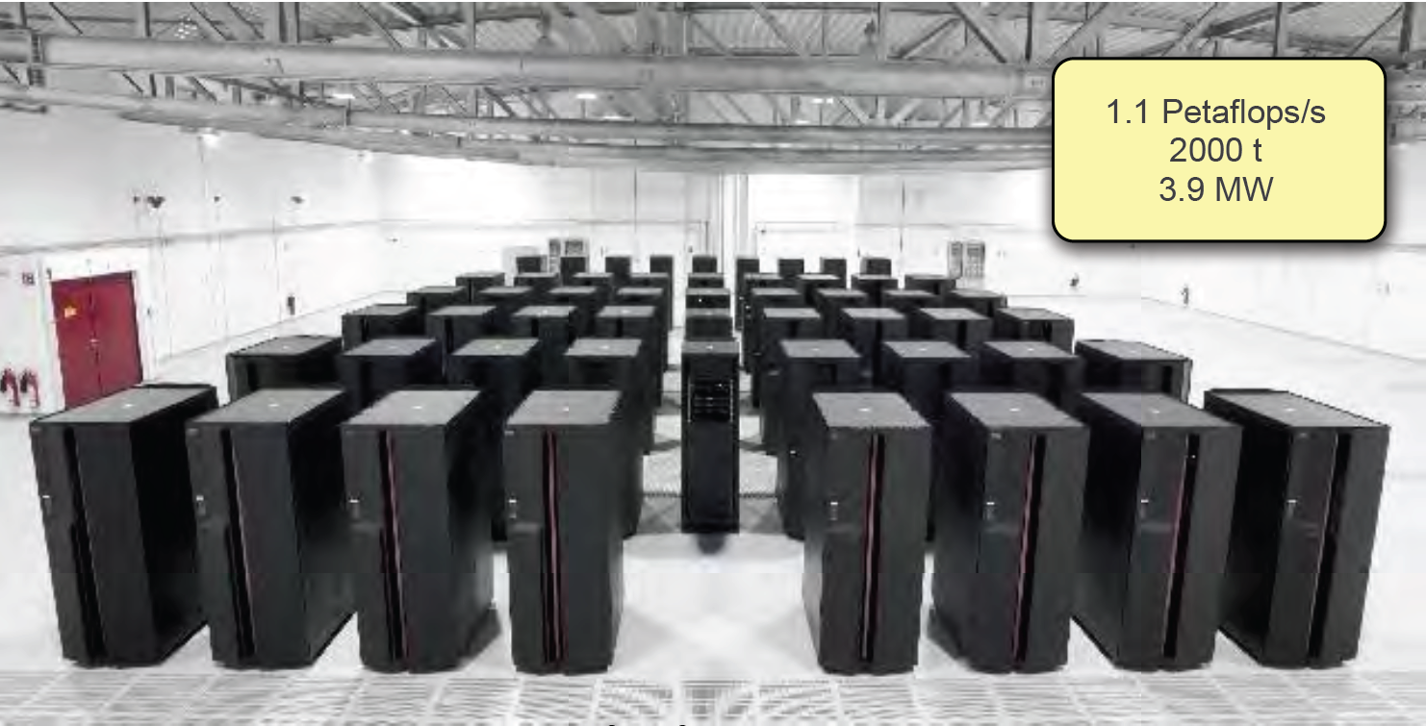

Principles: How powerful?
Roadrunner - Los Alamos
Quantum Bit
Multiple QuBits
Limit < 40 Qubit
Notes:
Resource, power in computation…
Kvantum mechanika alapjait erinto kerdeskor…
Fizika ket uj teruletenek a megszuletesehez vezetett…
Eroforrasava valt
Kvantum rendszerek szimulaciojat mar Feynman 82 megsejtette, 96 ban elso ilyen algoritmusok
Pl.:
Estimation of the eigenvalues and eigenvectors of a Hamiltonian (this algorithm invokes
the QFT), which can be used to find the energy levels of an atom for example [AL99].
• Simulation of the dynamics of many-body Fermi systems, using either first or second
quantized descriptions [AL97].
• Simulation of quantum chaos and localization [GS01].
Kvantum mechanika linearitasa miatt egy kvantum mechanikai logikai kapu
parhuzamosan transzformalja az osszes kombinaciojat a ket qubites allapotnak.
Jo tudni:
- Nehany fontos eset van, ahol exponencialisan jobb a kvantum szamitogep
- Normal szamitast pl. szamok osszeadasat nem gyorsitan fel a kvantum szamitogep
- Nem minden problema eseteben okoyna exponencialis sebesseg novekedest
Kvantum algoritmusok felfedezese uj dimenziokba helyezte fizika, szamitaselmelet es informacioelmelet tudomany agait.

Slide 13
Principles: How powerful?
Roadrunner - Los Alamos
Quantum Bit
Multiple QuBits
Limit < 40 Qubit
Quantum parallelism: parallel evaluations grow exponentially with the number of Qubits (≈2^{n})
+ 1 Qubit
Notes:
Resource, power in computation…
Kvantum mechanika alapjait erinto kerdeskor…
Fizika ket uj teruletenek a megszuletesehez vezetett…
Eroforrasava valt
Kvantum rendszerek szimulaciojat mar Feynman 82 megsejtette, 96 ban elso ilyen algoritmusok
Pl.:
Estimation of the eigenvalues and eigenvectors of a Hamiltonian (this algorithm invokes
the QFT), which can be used to find the energy levels of an atom for example [AL99].
• Simulation of the dynamics of many-body Fermi systems, using either first or second
quantized descriptions [AL97].
• Simulation of quantum chaos and localization [GS01].
Kvantum mechanika linearitasa miatt egy kvantum mechanikai logikai kapu
parhuzamosan transzformalja az osszes kombinaciojat a ket qubites allapotnak.
Jo tudni:
- Nehany fontos eset van, ahol exponencialisan jobb a kvantum szamitogep
- Normal szamitast pl. szamok osszeadasat nem gyorsitan fel a kvantum szamitogep
- Nem minden problema eseteben okoyna exponencialis sebesseg novekedest
Kvantum algoritmusok felfedezese uj dimenziokba helyezte fizika, szamitaselmelet es informacioelmelet tudomany agait.

Slide 14
Principles: How powerful?
Roadrunner - Los Alamos
Quantum Bit
Multiple QuBits
Limit < 40 Qubit
Quantum parallelism: parallel evaluations grow exponentially with the number of Qubits (≈2^{n})
+ 2 Qubit
Notes:
Resource, power in computation…
Kvantum mechanika alapjait erinto kerdeskor…
Fizika ket uj teruletenek a megszuletesehez vezetett…
Eroforrasava valt
Kvantum rendszerek szimulaciojat mar Feynman 82 megsejtette, 96 ban elso ilyen algoritmusok
Pl.:
Estimation of the eigenvalues and eigenvectors of a Hamiltonian (this algorithm invokes
the QFT), which can be used to find the energy levels of an atom for example [AL99].
• Simulation of the dynamics of many-body Fermi systems, using either first or second
quantized descriptions [AL97].
• Simulation of quantum chaos and localization [GS01].
Kvantum mechanika linearitasa miatt egy kvantum mechanikai logikai kapu
parhuzamosan transzformalja az osszes kombinaciojat a ket qubites allapotnak.
Jo tudni:
- Nehany fontos eset van, ahol exponencialisan jobb a kvantum szamitogep
- Normal szamitast pl. szamok osszeadasat nem gyorsitan fel a kvantum szamitogep
- Nem minden problema eseteben okoyna exponencialis sebesseg novekedest
Kvantum algoritmusok felfedezese uj dimenziokba helyezte fizika, szamitaselmelet es informacioelmelet tudomany agait.

Slide 15
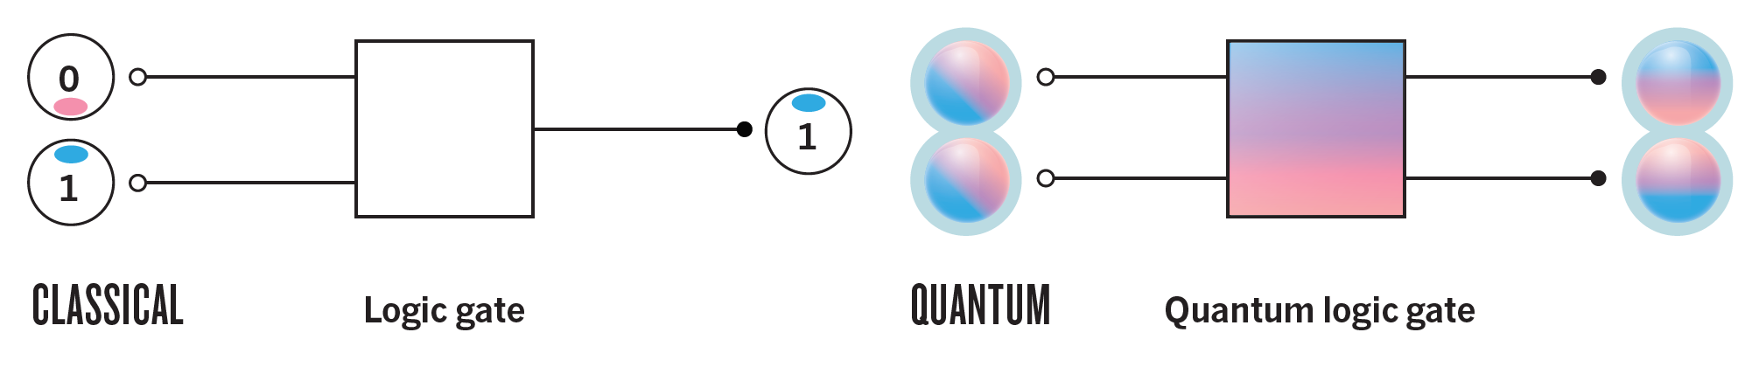
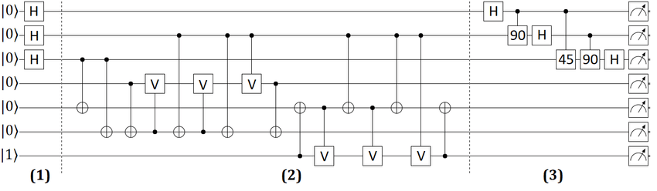
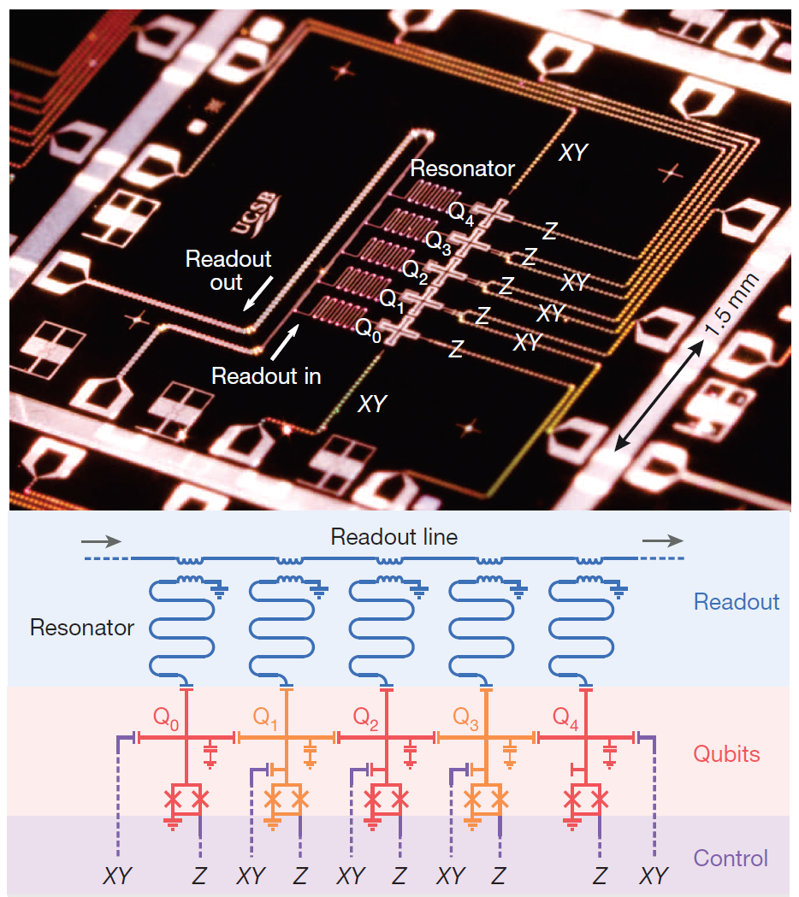
Quantum algorithms
Quantum gates: rotations on superpositions
V. Cărare, APS
Nature 543 (2017)
Quantum parallelism: all possibilities are analyzed at the same time – like searching through a database at once
Notes:
Coherence ←→ Coupling to surrounding, for readout, manipulation
100 -1000 qubit system would be competitve
Quantum parallelism
the number of parallel function evaluations grows exponentially with the size of the
quantum computer
Kvantum mechanika alapjait erinto kerdeskor…
Fizika ket uj teruletenek a megszuletesehez vezetett…
Eroforrasava valt
Kvantum rendszerek szimulaciojat mar Feynman 82 megsejtette, 96 ban elso ilyen algoritmusok
Pl.:
Estimation of the eigenvalues and eigenvectors of a Hamiltonian (this algorithm invokes
the QFT), which can be used to find the energy levels of an atom for example [AL99].
• Simulation of the dynamics of many-body Fermi systems, using either first or second
quantized descriptions [AL97].
• Simulation of quantum chaos and localization [GS01].
Kvantum mechanika linearitasa miatt egy kvantum mechanikai logikai kapu
parhuzamosan transzformalja az osszes kombinaciojat a ket qubites allapotnak.
Jo tudni:
- Nehany fontos eset van, ahol exponencialisan jobb a kvantum szamitogep
- Normal szamitast pl. szamok osszeadasat nem gyorsitan fel a kvantum szamitogep
- Nem minden problema eseteben okoyna exponencialis sebesseg novekedest
Kvantum algoritmusok felfedezese uj dimenziokba helyezte fizika, szamitaselmelet es informacioelmelet tudomany agait.

Slide 16
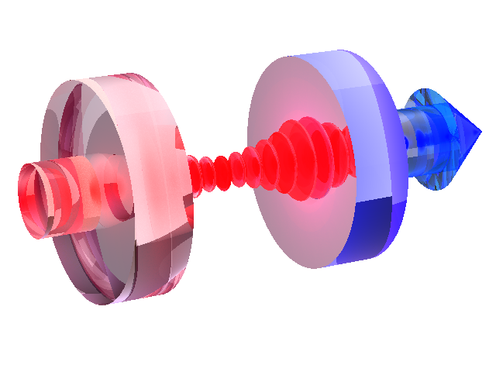
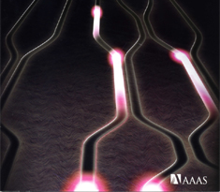
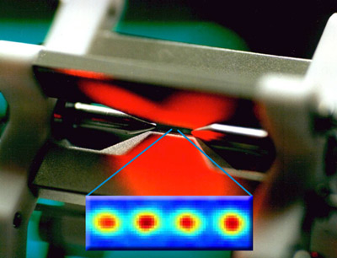
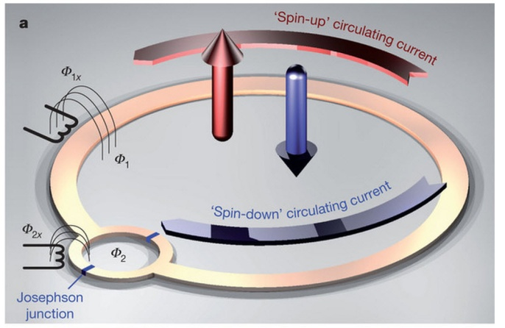
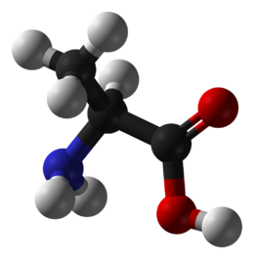
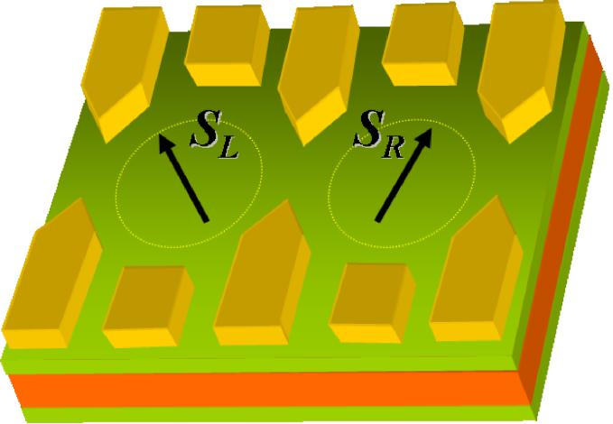

Technologies
Quantum systems with
control and manipulation
possibility
Photons
Cavity QED
Trapped ions
Superconductors
NMR
Quantum dots
…
In situ Error corrections!!!
Technology Roadmaps:
US http://qist.lanl.gov/,
EU http://qist ect it/Reports/
Blatt Quantum Machines, Les Houches Summer School (2011)
Notes:
Photons, easy to detect, fast, but difficult to localize
Geszti course
Domonkos Peter course

Slide 17
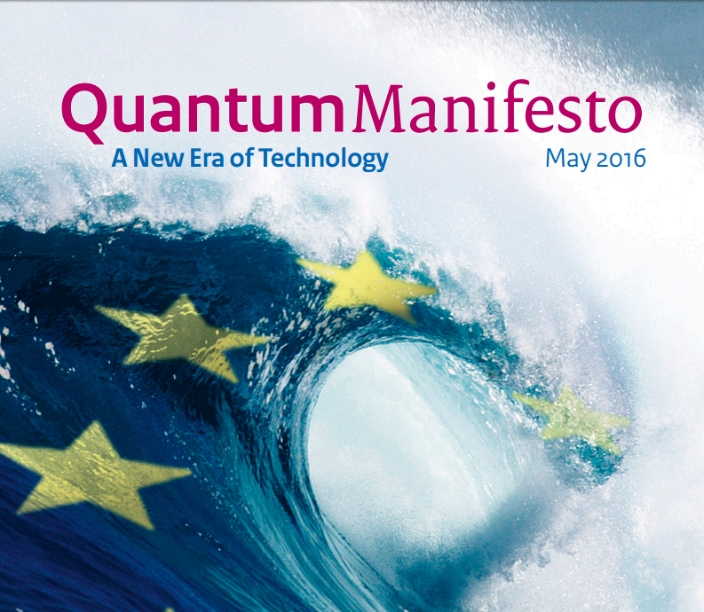

Quantum towards Technology
One from the 3 Flagship
project of the EU
2 x 5years program
Hungarian support
program 3.2BHUF
http://qurope.eu/manifesto
Notes:
Idea is to build S lead into a small quantum computer, which has two spin qubits. And by Single Quibit gates amnipulate spin state of the dot, then let a second electron to be injected from the superconductor and do state tomography.

Slide 18
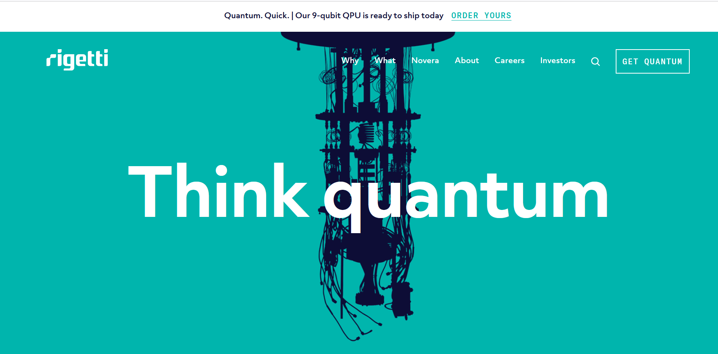
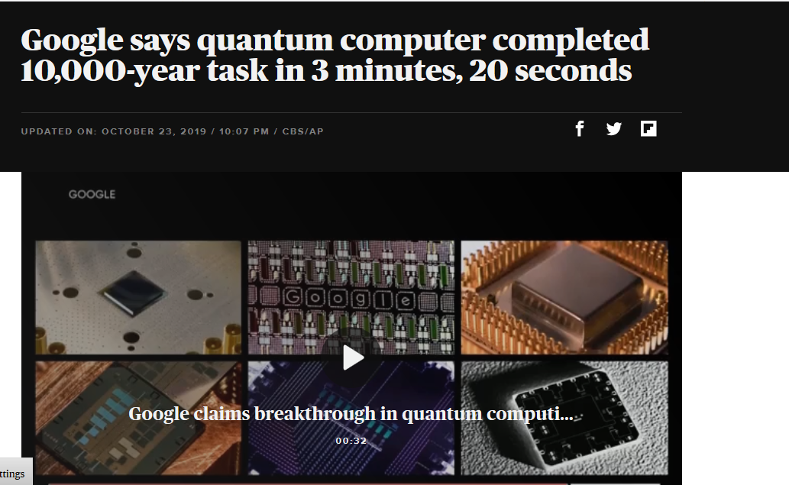
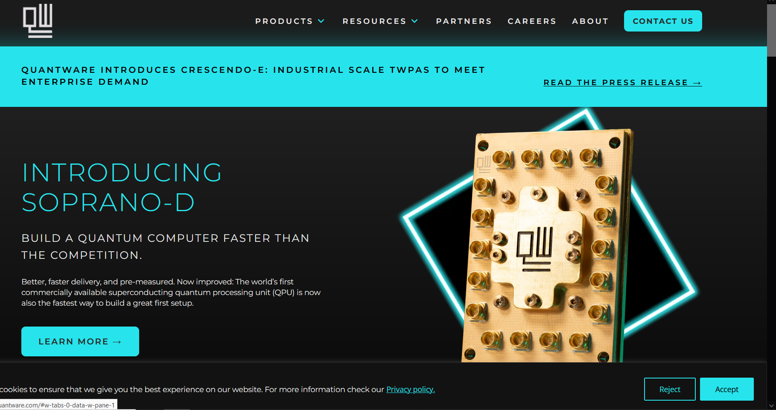
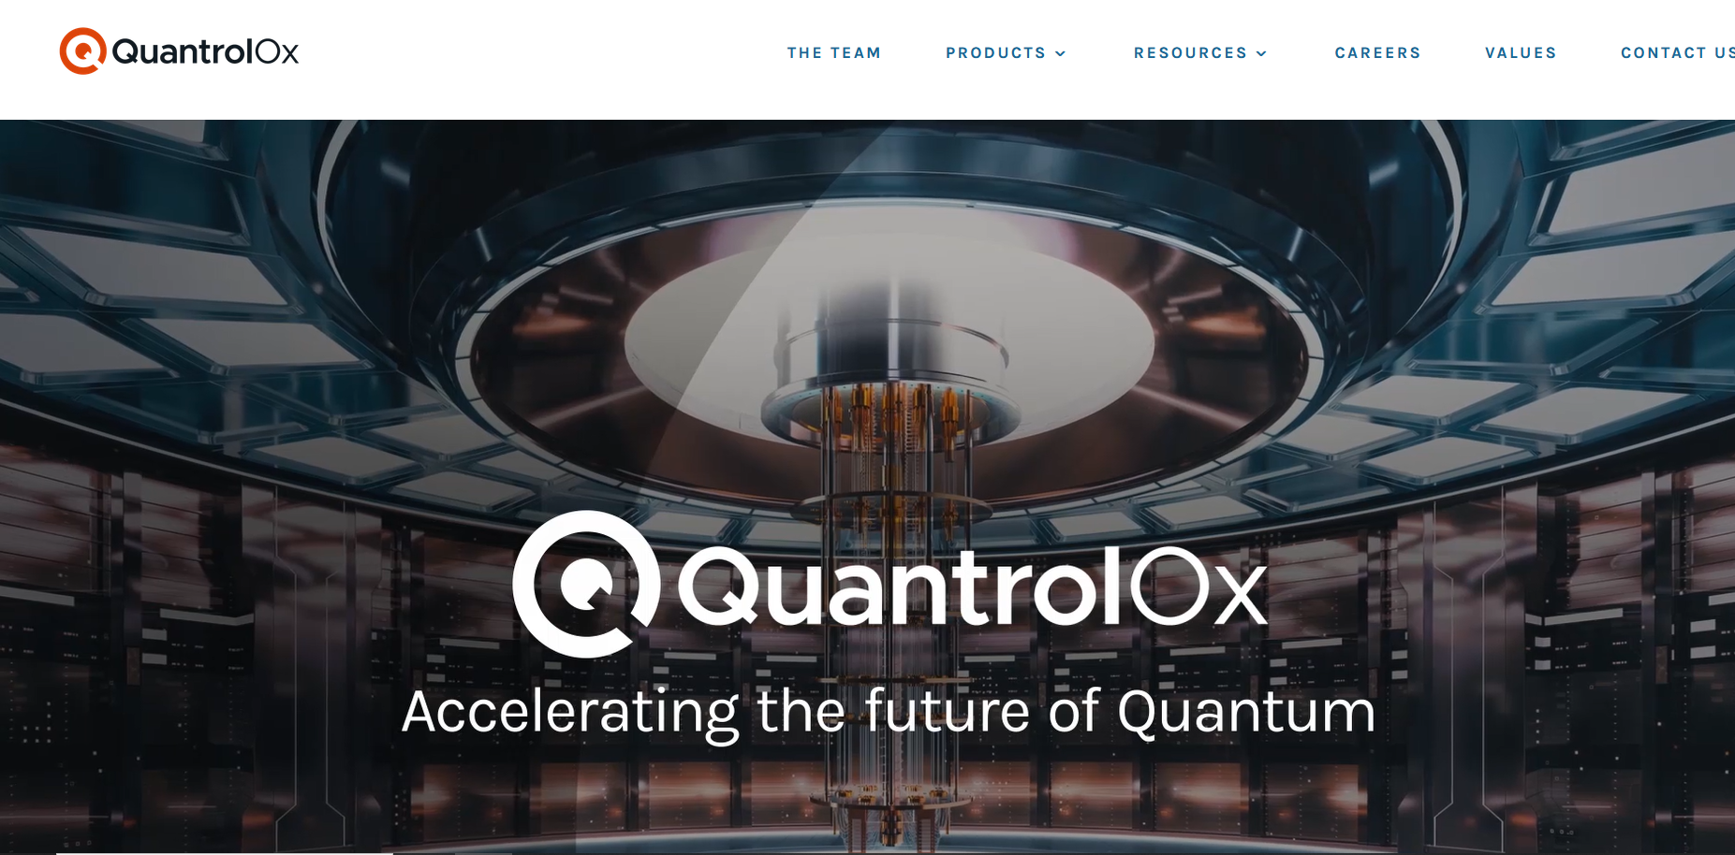
Quantum towards Technology
Notes:
Idea is to build S lead into a small quantum computer, which has two spin qubits. And by Single Quibit gates amnipulate spin state of the dot, then let a second electron to be injected from the superconductor and do state tomography.

Slide 19
Spin Qubits
- Qubit:
½ spin of single electron trapped into
a confinement potential
R. Hanson, Rev Mod Phys, 79, 1217 (2007)
Notes:
A. Palyi course
The internal degree of freedom, spin. The rotation of electron. It is an idal two level system.
Advantages of spin qubits compare to other systems:
- Inherent scalability
Compatibility with existing microelectronics industry
well- defined native qubits
potential to coupling to flying qubits
- Various matterial systems, strong development driven by nanotechnology (CNT, graphene, nanowires)
Disadvantege:
Linear structure

Slide 20
Spin Qubits
- Qubit:
½ spin of single electron trapped into
a confinement potential
R. Hanson, Rev Mod Phys, 79, 1217 (2007)
Notes:
Advantages of spin qubits compare to other systems:
- Inherent scalability
Compatibility with existing microelectronics industry
well- defined native qubits
potential to coupling to flying qubits
- Various matterial systems, strong development driven by nanotechnology (CNT, graphene, nanowires)
Disadvantege:
Linear structure

Slide 21
Spin Qubits
- Qubit:
½ spin of single electron trapped into
a confinement potential, Scalable system
Initialization of Qubits e.g. by B field
Single Qubit and by EDSR T≈150ns (2DEG) - 20ns (NW)
Two-Qubit gates based on exchange int. T ≈ 200ps
Readout Pauli-spin blockade (fidelity>90%)
Fast decoherence T₂ ≈ 10ns, T₂* ≈ 1us
Limited by hyperfine interaction
R. Hanson, Rev Mod Phys, 79, 1217 (2007)
Notes:
Amazing degree of control on single electrons has been achieved during the last 5-10 years.
Advantages of spin qubits compare to other systems:
- Inherent scalability
Compatibility with existing microelectronics industry
well- defined native qubits
potential to coupling to flying qubits
- Various matterial systems, strong development driven by nanotechnology (CNT, graphene, nanowires)
Disadvantege:
Linear structure

Slide 22
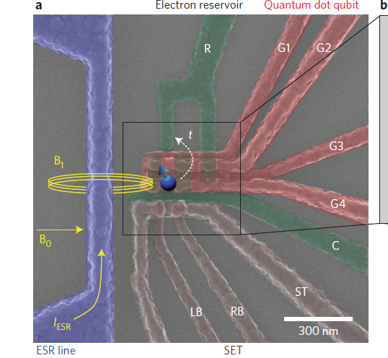
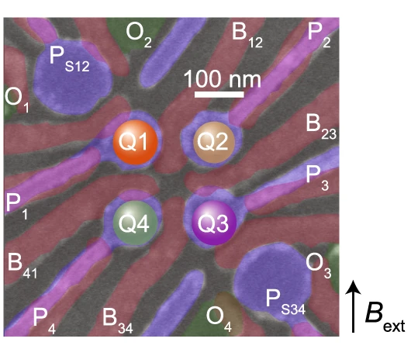
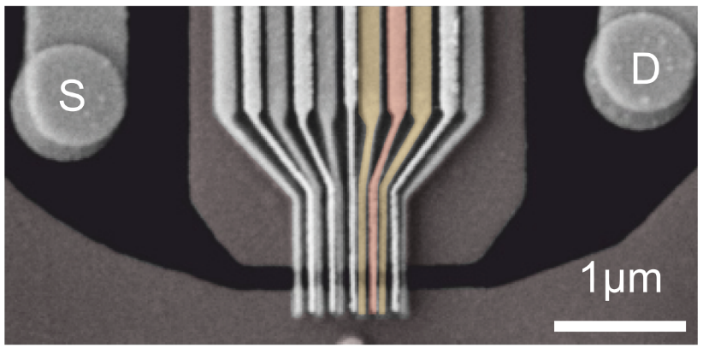
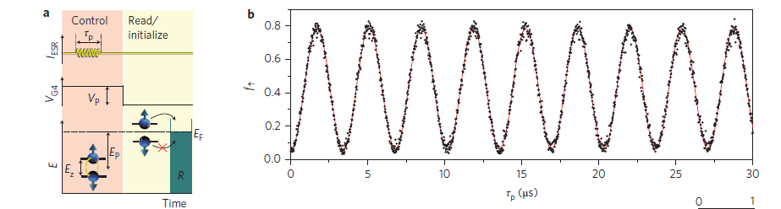
Spin Qubits, Various Material systems
Different materials
E.g. Ge
E.g. Si (28 purified)
W. I. L. Lawrie et al., Nat. Comm., 2023
E.g. Graphene
Stampfer group, Aachen
T₁~few s, T₂~50 ms
- Nuclear spin free system: C, Si/Ge
Nuclear polarization
Faster operation: Singlet-Triplet Qubit
Topologic protection
…
M. Veldhorst et al., Nature Nano 2014
Notes:
Improve coherence… different material system. Fast development of nanotechnology is a great resource….
Various ways to improve, technological challanges
Nanowires where parts with long coherence time (Si) for memory, and strong SO interaction to operate
Topological protection: Majoran Fermions. Have zero spin and charge, well isolated from the outside world.
This reachness of systems gives the power of solid state quantum machines.

Slide 23
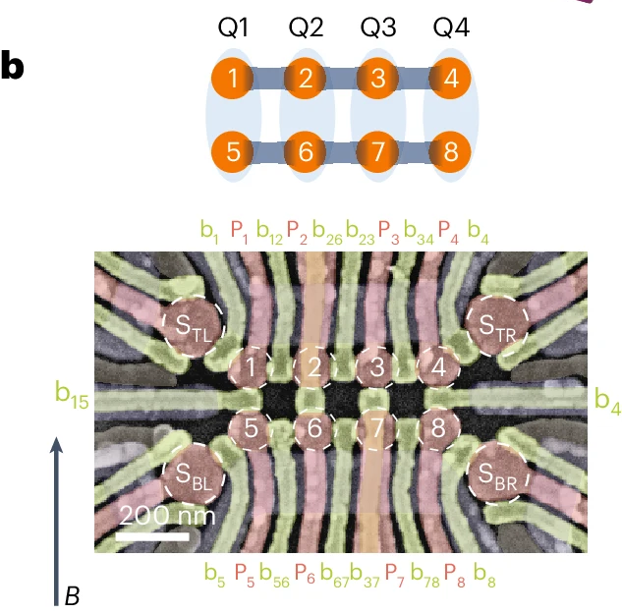
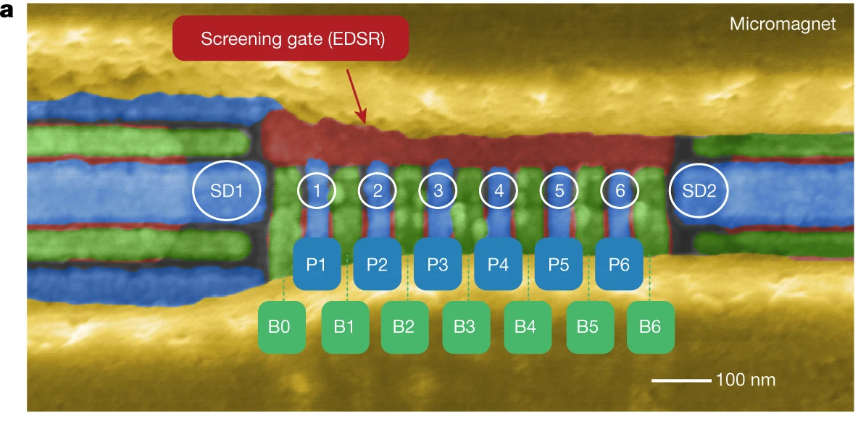
Mobile entangled electrons
…
1D architecture: interaction between neighboring qubits
Images: Vandersypen lab, Delft
Notes:
Coming back to the architecture. Qubits are in 1D array. Difficult to perform far distance operation. E.g. entanglment sending.
In addition quantum interfaces, convert info to other quantum system, e.g. for better isolation or better access.
Entanglement generation of flying spin qubits…

Slide 24
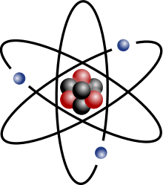
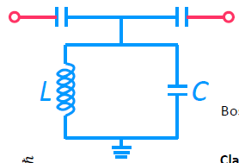
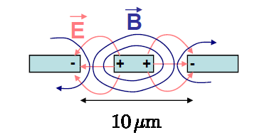


Readout with microwaves
Readout: Cavity QED
$$\overset{⃑}{E}$$
Fabry – Perot cavity for optics – using mirrors
$$H=−\overset{⃑}{d}\overset{⃑}{E}$$
R.J. Schoelkopf et al., Nature 451, 664 (2009)
M. Göppl, : J. Appl. Phys. 104, 113904 (2008)
Using SC resonators to study artificial atoms
Large Q resonators
Notes:
Coming back to the architecture. Qubits are in 1D array. Difficult to perform far distance operation. E.g. entanglment sending.
In addition quantum interfaces, convert info to other quantum system, e.g. for better isolation or better access.
Entanglement generation of flying spin qubits…

Slide 25
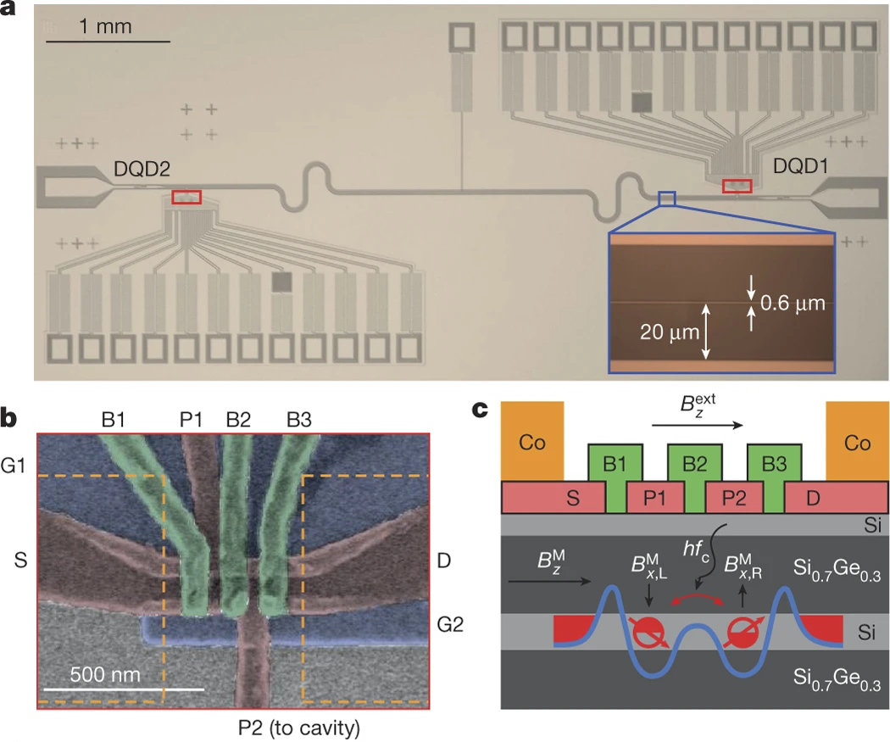
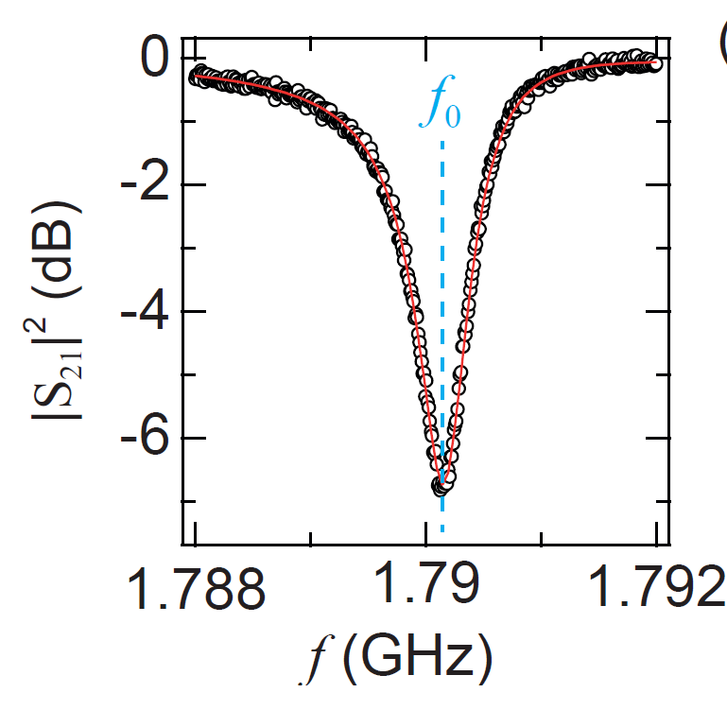

Readout with microwaves
Readout: resonator frequency depends on qubit state
Coupling and readout of spin qubits using SC resonators
Spin to photon coupling of information
f_{r}
$$κ$$
X. Mi et al., Nature 2018
Notes:
Coming back to the architecture. Qubits are in 1D array. Difficult to perform far distance operation. E.g. entanglment sending.
In addition quantum interfaces, convert info to other quantum system, e.g. for better isolation or better access.
Entanglement generation of flying spin qubits…

Slide 26
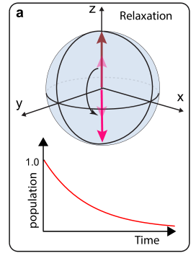




Challenges
$$|1>$$
$$|0>$$
Needs low error rates <<1%
Maybe error correction
Better qubits?
Notes:
Coming back to the architecture. Qubits are in 1D array. Difficult to perform far distance operation. E.g. entanglment sending.
In addition quantum interfaces, convert info to other quantum system, e.g. for better isolation or better access.
Entanglement generation of flying spin qubits…

Slide 27







Scaling
Challenges:
Scaling up
72 qubits @ Google Bristlecone
European network for 100 qubit processor:
HUN Partners: BME & Wigner
Notes:
Coming back to the architecture. Qubits are in 1D array. Difficult to perform far distance operation. E.g. entanglment sending.
In addition quantum interfaces, convert info to other quantum system, e.g. for better isolation or better access.
Entanglement generation of flying spin qubits…

Slide 28



Research @ BME
Research direction: combine semiconductor/SC qubit properties
Develop novel qubit types that might be resistant to information loss (topological systems)
Notes:
Coming back to the architecture. Qubits are in 1D array. Difficult to perform far distance operation. E.g. entanglment sending.
In addition quantum interfaces, convert info to other quantum system, e.g. for better isolation or better access.
Entanglement generation of flying spin qubits…

Slide 29
New Directions in Electronics
LBohr
Le
Lφ
Lspin
Spintronics
Quantumelectronics
Molecular
electronics
Memristors
Notes:
29
To print: 1,4,5,7,8,9,15,16,18,23,24,25,26,29,30,31,34,35,40,41,43,46,47,48,51,55,60,61,62,63
Hosszutav jovo elektornikaja
Folztatni a miniaturiyalast → molekularis elektronika
Uj koncepciokat kidolgozni szamitasokra…
Kis meret tartomanyban maskeppen viselkedik egy eszkoz. Pl. Kvantummechanikailag,
Vagy ballisztikusan → elektron optika
Szamos objektum nanotechnologia teruleterol, amibol aramkoroket lehet kesziteni.

Slide 30

A possible realization of resistive switching
Ag₂S memristor (memory + resistor): Ag electrode + thin Ag₂S layer + electrochemically inert Me tip (e.g. PtIr or Nb).
Positive bias (on the Ag electrode): Ag⁺ ions move towards the Me tip → an Ag filament is grown between the two electrodes → low resistance ON state
Negative bias: the Ag filament is destructed → high resistance OFF state
K. Terabe et al., Adv. Mater 8, 536 (2007).
I
R_{ON}
I(V) characteristics: linear resistive behavior at low bias, switching to ON/OFF state above a positive/negative threshold → ideal for memory operation
R_{OFF}
V
Resistive Random Access Memory (ReRAM)

Slide 31
Requirements against real ReRAM devices
Write/erase voltage level: < 2 Volt
Write/erase times: < 100 ns
Read-out voltage level: < 1 Volt
Read-out current level: ~ 0.001 – 1 mA
OFF to ON resistance ratio > 2
OFF state resistances < 100 kΩ
Endurance > 10⁷ writing cycles
Retention times > 10 years
Non-volatility also during read-out operations
CMOS competitive scaling
CMOS compatible material systems and technology
R. Waser et al., Adv. Mat. 21, 2632 (2009).
J. J. Yang et al., Nat. Nanotech. 8, 13 (2013).
A real resistive memory device must comply to ALL of the above requirements

Slide 32
















ReRAM mass storage media
Data created worldwide: >10¹⁸ byte/day
alltogether: >10²² byte
FLASH
memory
performace
FLASH memory
Crossbar ReRAM
Further possibility: neuromorphic computing

Slide 33



From nanoelectronics to neuroscience
Close analogy to the human nervous system, including learning and forgetting abilities: ideal for neural network modeling
T. Hasegawa et al., Adv. Mat. 24, 252 (2012).

Slide 34





Von Neumann computers
-Digital (0,1)
-Physically separated functionalities (processor & memory)
-General purpose hardware, software encoded tasks
-Difficult to handle deep neural networks:
Software
implementation:
~n² operations
Key operation:
Vector-matrix multiplication

Slide 35



Neuromorphic computing
-Analog
-In memory computing
-Possible building blocks: memristors as artificial synapses
Memristive crossbar:
single-step
hardware multiplication

Slide 36



How advanced is memristor technology?
128 x 64 Ta/HfO₂/Pd crossbar
5-8 bit resolution
Training on MNIST handwritten digit database.
91.7% classification accuracy
1T1R arrangement, the transistor selects the devicies along the training, but oll transistors are open during inference
Efficient and self-adaptive in-situ learning in multilayer memristor neural networks NATURE COMM. 9:2385 (2018)
Notes:
11% unresponsive devices – self-adaption to hardware imperfecions
Simulations predict 97% accuracy with 1024x512 arrays

Slide 37





How noisy are the memristors?
$≈0.025⋅\frac{2e^{2}}{h}$

Slide 38






What is the fastest switching?
10 picosecond switching (world record)

Slide 39
New Directions in Electronics
LBohr
Le
Lφ
Lspin
Spintronics
Quantumelectronics
Molecular
electronics
Memristors
Notes:
39
To print: 1,4,5,7,8,9,15,16,18,23,24,25,26,29,30,31,34,35,40,41,43,46,47,48,51,55,60,61,62,63
Hosszutav jovo elektornikaja
Folztatni a miniaturiyalast → molekularis elektronika
Uj koncepciokat kidolgozni szamitasokra…
Kis meret tartomanyban maskeppen viselkedik egy eszkoz. Pl. Kvantummechanikailag,
Vagy ballisztikusan → elektron optika
Szamos objektum nanotechnologia teruleterol, amibol aramkoroket lehet kesziteni.

Slide 40






  Spin in a magnetic field (Zeeman effect)
Spin: internal degree of freedom
Stern-Gerlach experiment
Spin operator
4d¹⁰5s¹
Magnetic moment
The torque acting on a spin in a homogeneous magnetic field
Hamiltonian

Slide 41






  Ferromagnets
Origin exchange interaction (Coulomb interaction + Pauli principle)
Stoner model
Gain in Coulomb interaction if spin-polarized, but higher kinetic energy
In d-metals, with narrow band and high DOS spin-polarization can win
Magnetization
Spin polarization
$$P=\frac{ρ^{↑}−ρ^{↓}}{ρ^{↑}+ρ^{↓}}$$
Anisotropy (SO+crystal field or from shape)
Magnetization tends to align along certain directions
Magnetization dynamics
Slow rotation in perpendicular direction
Switching along the easy direction
Anisotropy protects magnetic state

Slide 42








GMR - Giant Magneto Resistance
Nobel prize- 2007
P
AP
GMR basic model:
Two separated current channels for spin up and spin down – no spin-flip scattering involved.
Description: resistor model - one spin species (P or AP with magnetization ) are scattered more due to different DOS. Result: increase of resistance for that channel (large resistor boxes).
R^{P}<R^{AP}

Slide 43



GMR - Giant Magneto Resistance
Nobel prize- 2007
P
AP
GMR basic model:
Two separated current channels for spin up and spin down – no spin-flip scattering involved.
Description: resistor model - one spin species (P or AP with magnetization ) are scattered more due to different DOS. Result: increase of resistance for that channel (large resistor boxes).
The magnetization of one of the layers can be fixed (e.g. with an antiferromagnet – single switching
R^{P}<R^{AP}

Slide 44








TMR - Tunneling Magneto Resistance
Tunnel barrier between two magnetic layers
Growth of oxides with atomic precision
The current is proportional to the DOS (both initial and final state). The current will be different in the P and AP configuration. Spin conserving tunneling assumed.
Giant spin signals can be achieved
The structure is often called spin-valve
Polarizáció
$$P_{1}=\frac{ρ_{M1}−ρ_{m1}}{ρ_{M1}+ρ_{m1}}$$
$$P_{2}=\frac{ρ_{M2}−ρ_{m2}}{ρ_{M2}+ρ_{m2}}$$
$$TMR=\frac{ΔR}{R_{p}}=\frac{R_{AP}−R_{P}}{R_{P}}=$$
$$\frac{G_{P}−G_{AP}}{G_{AP}}=\frac{2P_{1}P_{2}}{1−P_{1}P_{2}}$$

Slide 45



Magnetic data storage
GMR/TMR sensors are used also in the read head of hard drives. Hard drives contain small magnetic islands.
Readout: the magnetic field of the island will flip the sensor.
Writing: inductive coupling – writing currents
Magnetic domains in an HDD imaged by TEM
Source: T. Santos
TMR spin valves are also used in memory cells:
MRAM - 0 and 1-s are encoded to single spin valves
Readout : small current via TMR effect
Writing: passing current on the bit and word lines at the same time

Slide 46



Spin injection
The non-equilibrium imbalance in the subband occupation results in a difference in the chemical potential corresponding to the different spin-subbands. This difference decays toward the bulk of the non-magnetic metal
FM-NM interface
current
Full description: Valet-Fert model relying on the Boltzmann equation applied for two subbands.
exponential cutoff:
diffusive spin transport:
very low efficiency for semiconductors
OK for metals and graphene
The spin polarization drops at the interface
the amplitude of the GMR is proportional to the remaining spin polarization
G. Schmidt et al., PRB 62, R4790 (2000)
J. Bass et al., J. Phys.: Condens. Matter 19, 183201 (2007)

Slide 47



Non-local spin measurement
The imbalance of the chemical potentials can be detected, without the interference of the direct current path
As the in-plane field is swept both the detector and injector switches (at different fields)
From several samples, spin-diffusion length obtained
N. Tombros et al, Nature, 448, 571 (2007)

Slide 48




Hanle spin precession measurement
Larmor frequency
In a 1D ballistic system a cosine precession is expected
Diffusion and relaxation makes it more complex
Spin relaxation time can be obtained from fitting
P/AP the sign is opposite
rotation of 180°
N. Tombros et al, Nature, 448, 571 (2007)

Slide 49





Spin Hall effect
Hall effect:
An electric field along the y coordinate is built up in the sample
Quasi-classical description: the charge carriers moving in a perpendicular magnetic field are deflected due to the Lorentz force
y
k_{i}
k_{f}
No net voltage drops along the y direction, but an opposite spin polarization arises at the edges
y
Spin polarization – detected by magneto optics
Does not require an external magnetic field nor a FM electrode!
Small effect (10⁶A/cm²):
Y. K. Kato et al., Science 306, 1910 (2004).
J. E. Hirsch, Phys. Rev. Lett. 83, 1834 (1999)

Slide 50






  Inverse spin Hall effect
How to measure it?
Spin injection: using FM contacts
In actual nonlocal experiments, there is no net current through the device, but spin diffusion/current appears
Idea: if the incident current is already spin polarized, then a measureable voltage develops (e.g. more down spins accumulate than up spins → Hall voltage)
At zero B-field magnet polarization is in-plane.
j ~ j_{s} × s, out-of-plane magnetic field (and spinpol) is necessary to have a transverse spin current and a Hall voltage
the device is characterized using FM2 in a standard nonlocal measurement
magnetic field
S. O. Valenzuela and M. Tinkham, Nature, 442, 176 (2006)

Slide 51



  Spin transfer torque
previously: versatile devices, but an external magnetic field is necessary to manipulate spin states. All electric control would be better.
The free layer is rotated by the current instead of the external magnetic field. The structures are however similar.
I
free layer
spin polarized current
I
Potential application: memory cell
write: STT with high current pulse
read: GMR/TMR at low current
spin polarized current
Current density: 10⁹ A/cm²
Only feasible at the nanometer-scale!
Dominate above Oersted fields
Heating happens away from the contact region
D. C. Ralph et al., J. of Magn. Mag. Mater. 320, 1190 (2007)

Slide 52

  Spin orbit torque
Spin orbit switching
Co with out of plane magnetization (extra thin) Pt Hall cross. With current generate spin polarization which acts with a torque on the FM.
Readout: measure Hall voltage on the heterostructure – AHE in the FM material
Spin orbit torque:
Spin polarization is generated in the substrate with large SOC using a current. The mechanism is either SHE effect or Rashba Edelstein effect.
The SOC generated spin current switches the FM.
Readout: e.g. via anomalous Hall effect
I. M. Miron et al., Nature, 476, 189 (2011)

Slide 53
  Spintronics
Literature:
J. Fabian et al., Semiconductor spintronics, Acta Physica Slovaca 57, 565 (2007) and arXiv:0711.1461
I. Zutic, J. Fabian and S. Das Sarma, Spintronics: Fundamentals and applications, Rev. Mod. Phys. 76, 323 (2004)
D. C. Ralph and M. D. Stiles, Spin transfer torques, J. Magn. Mag. Mater. 320, 1190 (2007)
T. Jungwirth et al., Spin Hall effect devices, Nat. Materials 11, 382 (2012)
and more.... See references
Nanofizika tudásbázis, fizipedia.bme.hu (in Hungarian)

